Slide 1
Presentation On shiny
- By Group B

Slide 2
Basics

Slide 3
Shiny
Shiny Framework is basically a web framework which help to develop web application within the R.

Slide 4
Benefits
Diversity- You can communicate results via interactive charts, visualizations, text, or tables.
Ease-of-use- If you already know R, you can rapidly develop a cool Shiny app.
Share-ability- Built-in capabilities let you share your work easily with colleagues and friends.

Slide 5
UNDERSTAND THE ARCHITECTURE

Slide 6
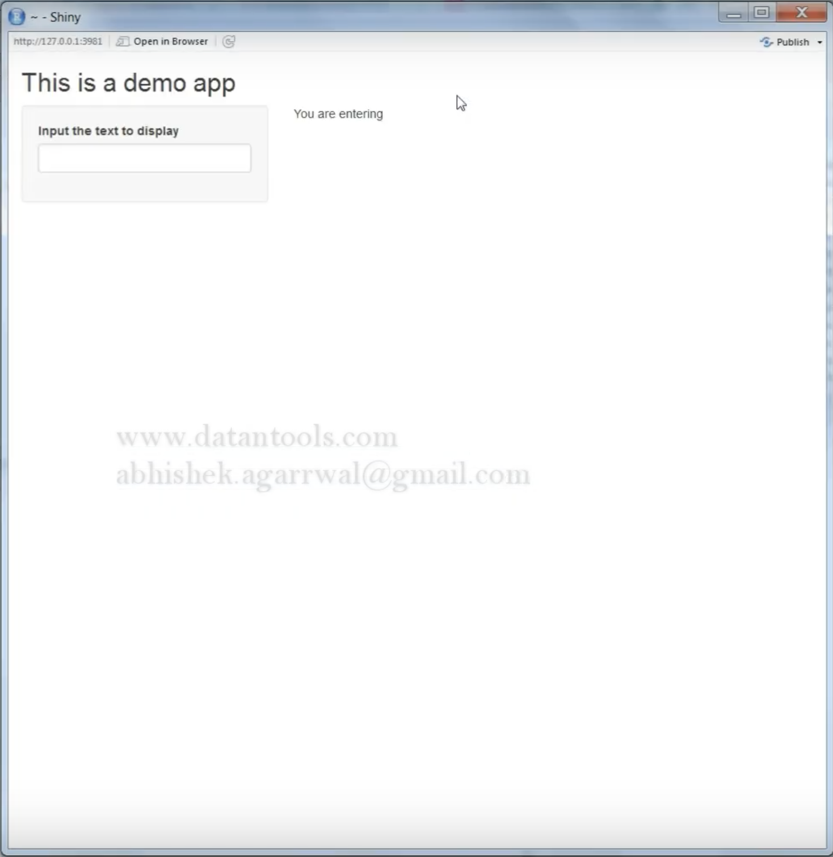
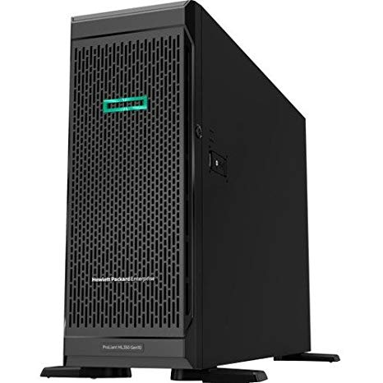


Slide 7
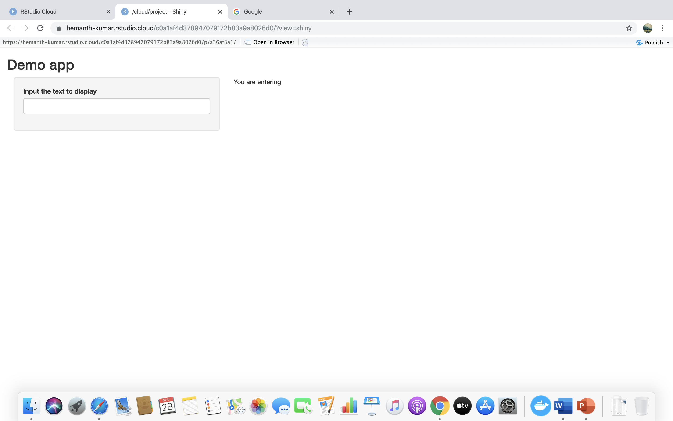




Slide 8
App template
library(shiny)
ui <– fluidpage()
server <- function(input, output) {}
shinyApp(ui = ui, server = server)

Slide 9
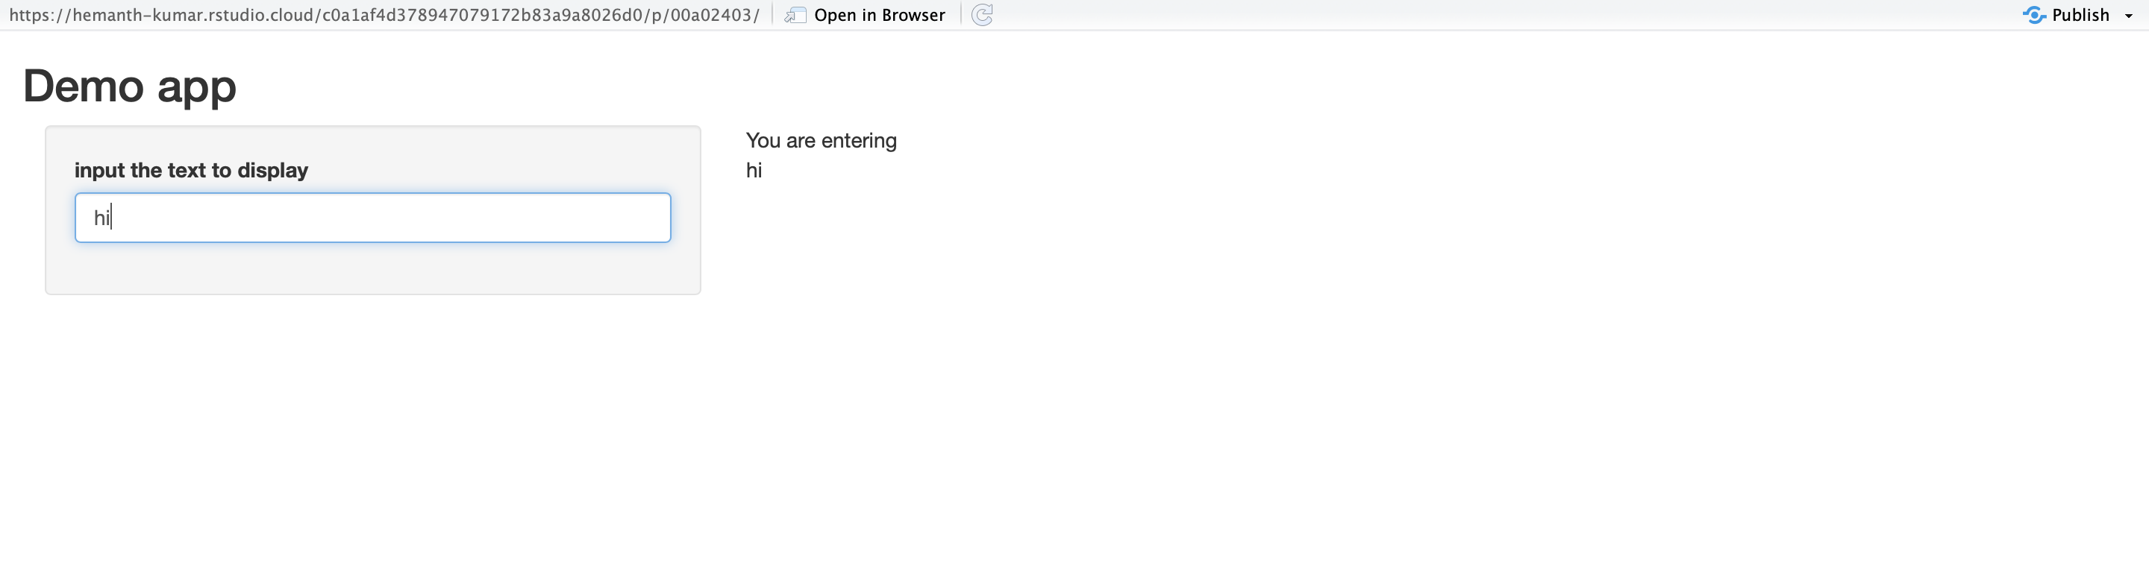
Build your app around inputs and outputs

Slide 10
ui <- fluidpage(
# *Input()functions,
# *output()functions
)

Slide 11
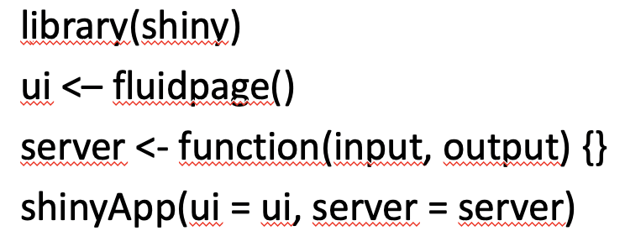
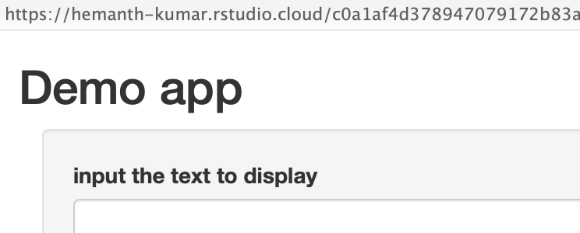
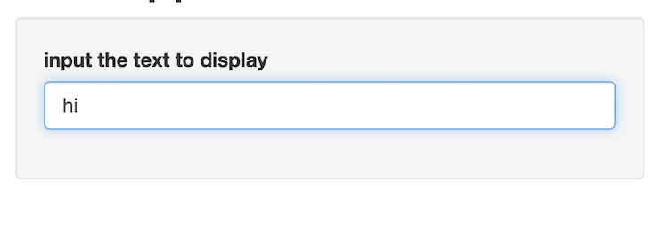
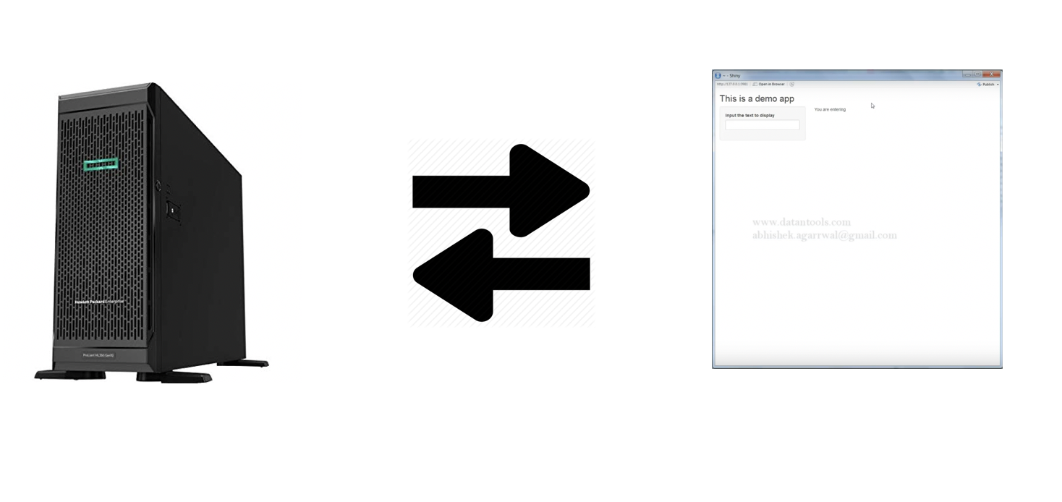
Recap
Begin each with a template
Add elements as arguments to fluidpage()
Create reactive input with an input() function
Display reactive results with an output() function
Use the server function to assemble inputs into outputs

Slide 12
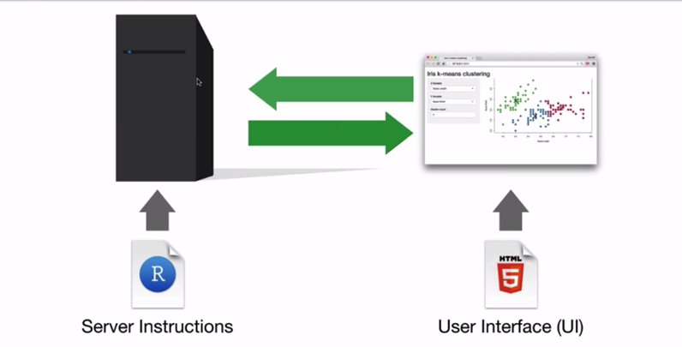
INPUTS

Slide 13
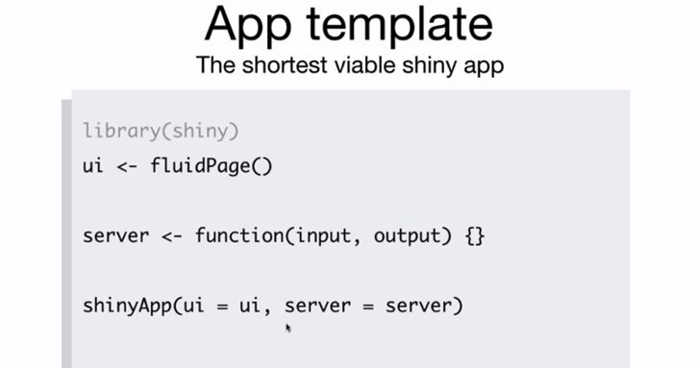

Slide 14
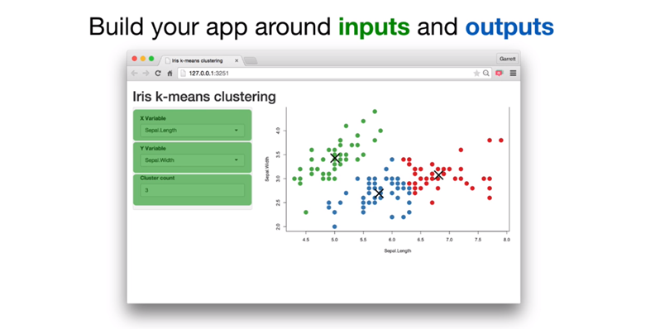

Slide 15
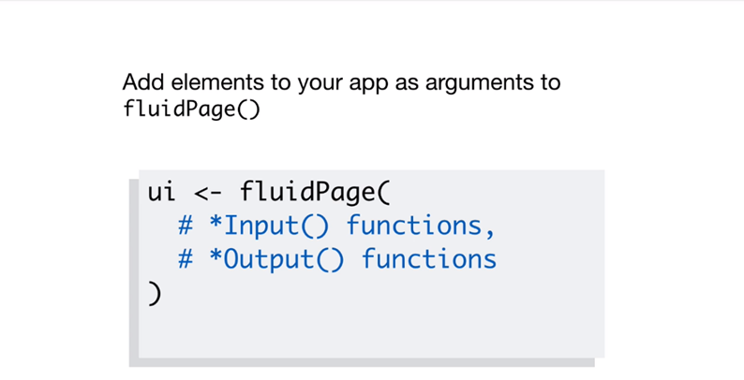

Slide 16


Slide 17
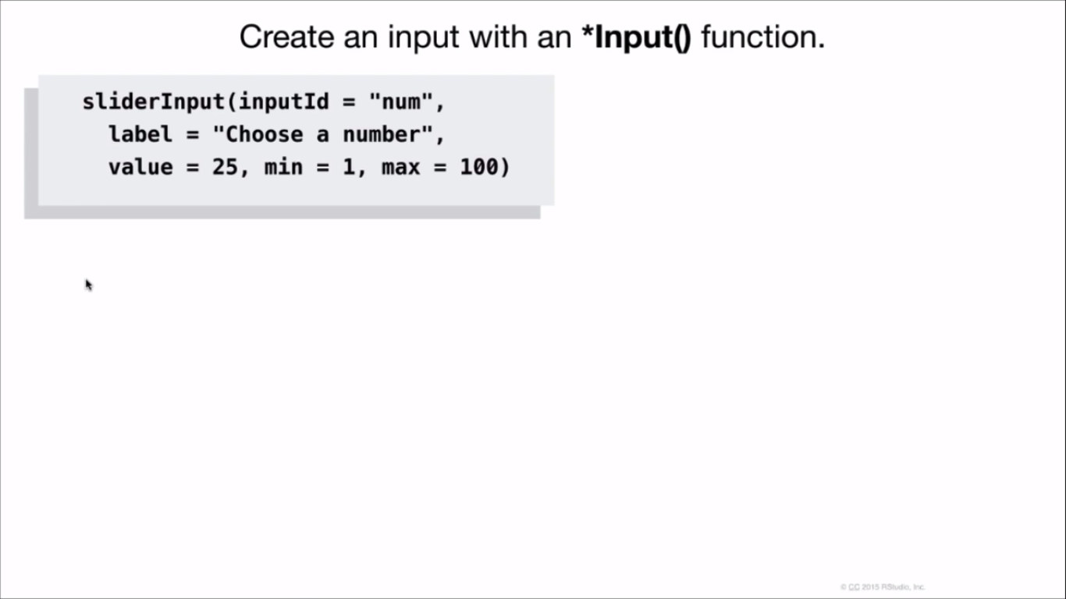

Slide 18
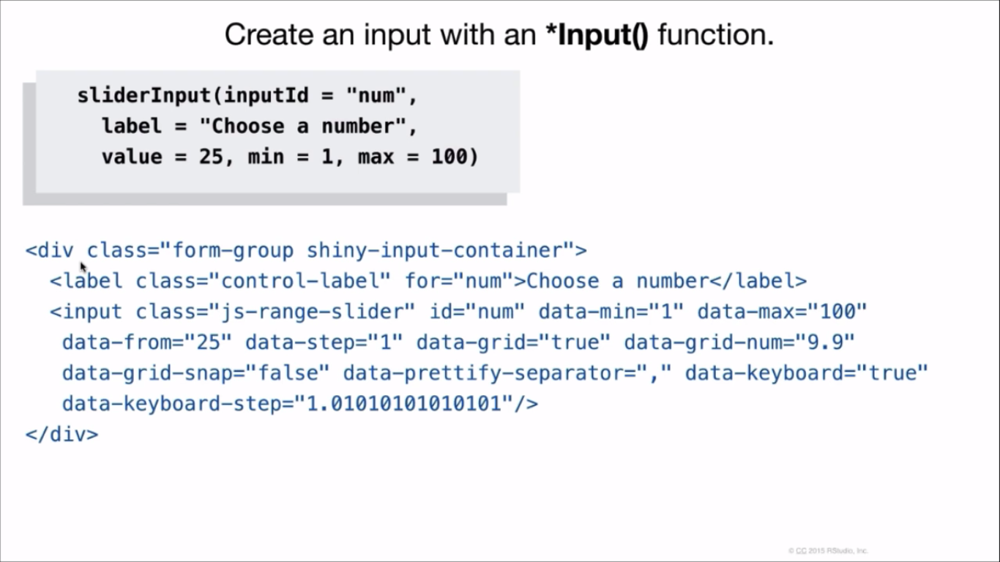

Slide 19
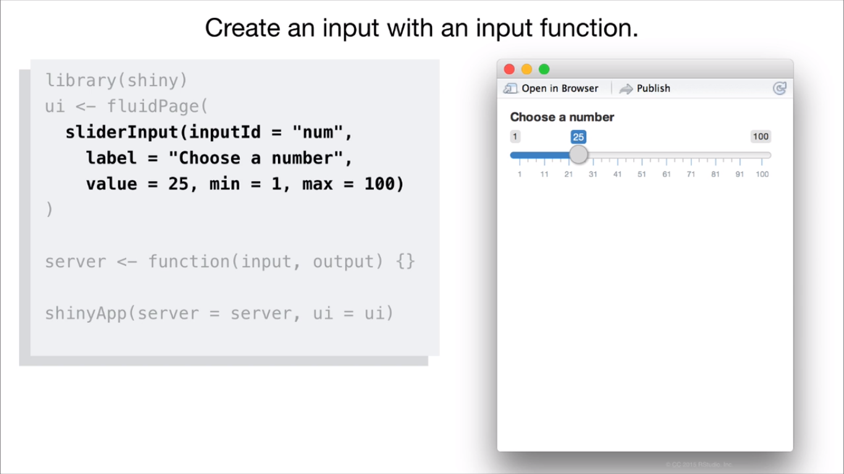

Slide 20


Slide 21
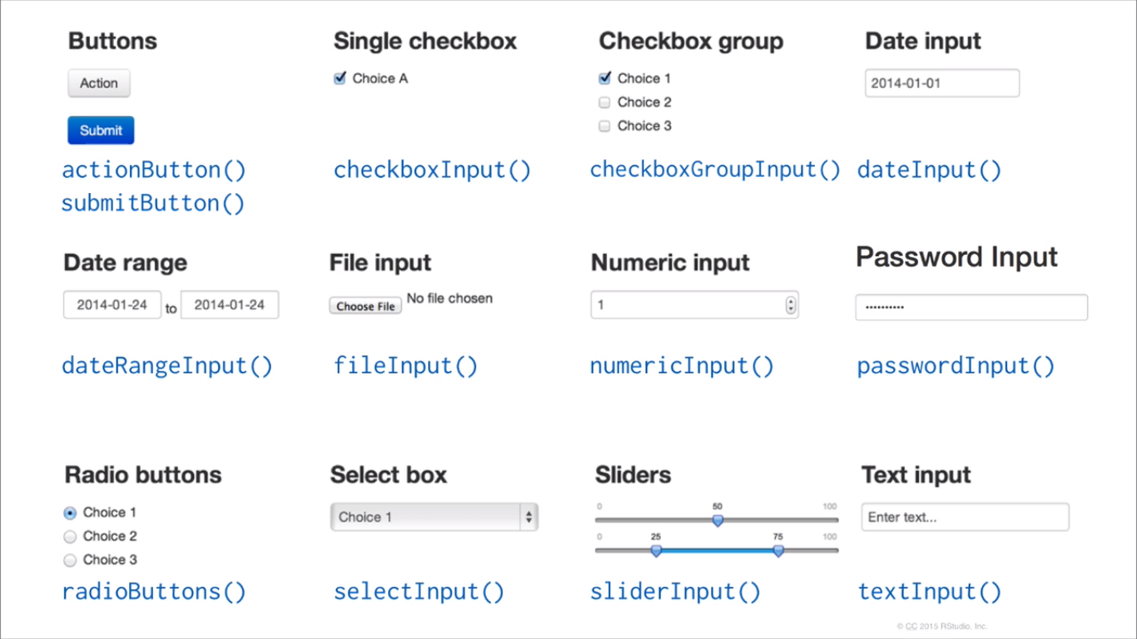

Slide 22
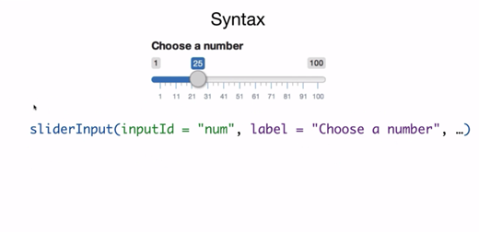

Slide 23
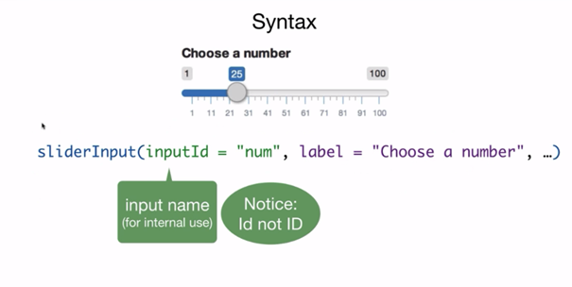

Slide 24
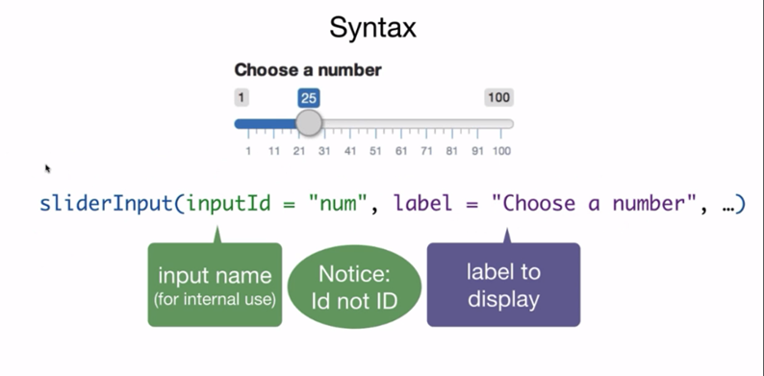

Slide 25
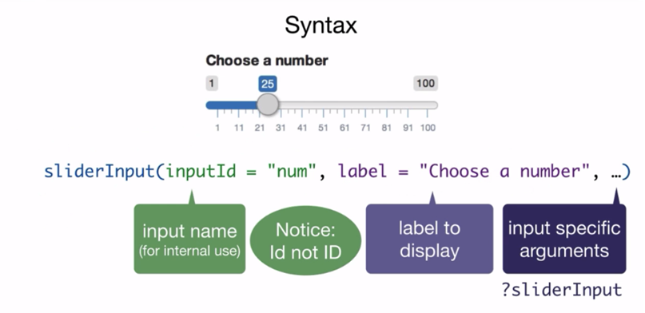

Slide 26
Out Puts:
renderDataTable
renderImage
renderPlot
renderPrint
renderTable
renderText
renderUI

Slide 27
DT::renderDataTable:
renderDataTable(expr, options, callback, escape, env, quoted)
Expr: An expression that returns a data frame or a matrix.
Options: A list of initialization options to be passed to DataTables, or a function to return such a list.
Escape: Whether to escape from table.
Env: This function helps to evaluate the expr.

Slide 28
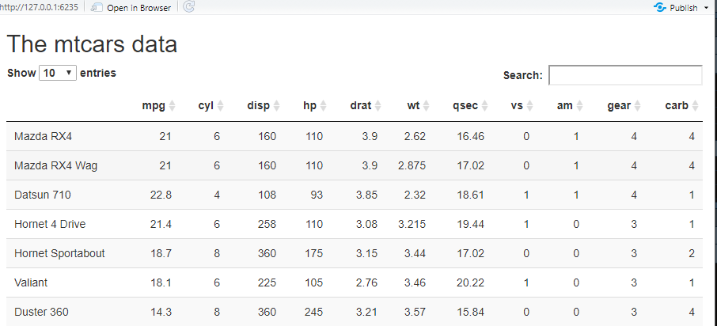
#rendertabledata
install.packages("DT")
library(DT)
library(shiny)
ui = basicPage(
h2("The mtcars data"),
DT::dataTableOutput("mytable")
)
server = function(input, output) {
output$mytable = DT::renderDataTable({
mtcars
})
}
shinyApp(ui, server)

Slide 29
DT::renderImage:
renderImage(expr, env, quoted, deleteFile )
Expr: An expression that return list.
Env: This function helps to evaluate the expr.
deleteFile: This function helps to delete the image after it is being sent.

Slide 30
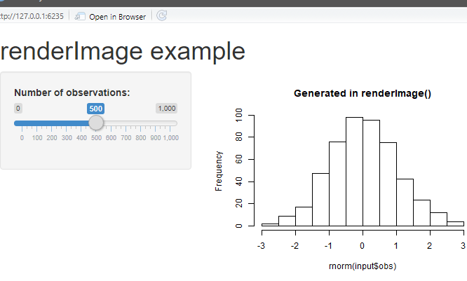

Slide 31
DT::renderPlot:
renderPlot(expr, width, height, res, env, quoted, func)
Exp: Expression that generates the graph
Width/height: This function helps to specify the size of the image
Res: This function used to specify the resolution of the image

Slide 32
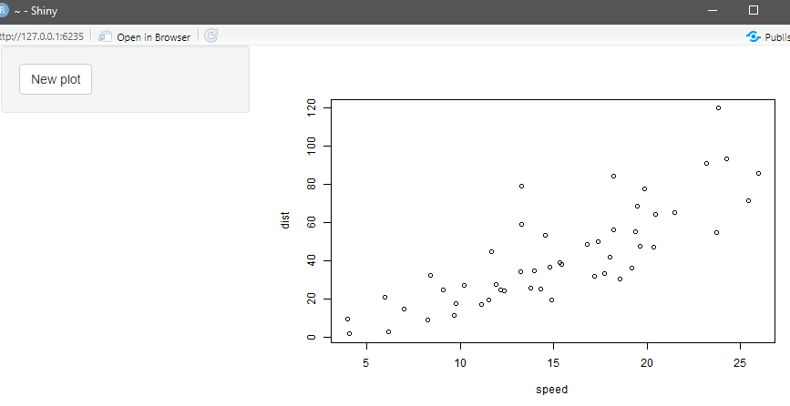
if (interactive()) {
shinyApp(
ui = fluidPage(
sidebarLayout(
sidebarPanel(
actionButton("newplot", "New plot")
),
mainPanel(
plotOutput("plot")
))),
server = function(input, output) {
output$plot <- renderPlot({
input$newplot
# Add a little noise to the cars data
cars2 <- cars + rnorm(nrow(cars))
plot(cars2)
})
}
)
}

Slide 33
DT::renderPrint:
renderPrint(expr, env, quoted, width, func)
Expr: An expression that may print out and/or return a printable R object
Env: The environment in which to evaluate the expr
Width: The value for option print

Slide 34
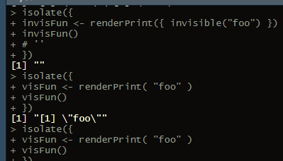
isolate({
visFun <- renderPrint( "foo" )
visFun()
})
# '[1] "foo"'
isolate({
invisFun <- renderPrint({ invisible("foo") })
invisFun()
# ''
})

Slide 35
DT::renderTable:
renderTable(expr, env, quoted, func)
Expr: An expression that returns an R object
Env: The environment in which to evaluate the expr
Quoted: Is expr is a quoted expression(with quote())? This is useful if you want to save the expression in variable

Slide 36
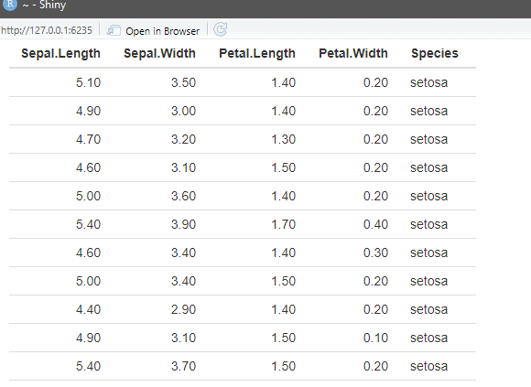
#rendertable
if (interactive()) {
# table example
shinyApp(
ui = fluidPage(
fluidRow(
column(12,
tableOutput('table')
)
)
),
server = function(input, output) {
output$table <- renderTable(iris)
}
)
}

Slide 37
DT::renderText:
renderText(expr, env, quoted, func)
Expr: An expression that returns an R object that can be used as an argument to cat
Env: The environment in which to evaluate the expr
Quoted: : Is expr is a quoted expression(with quote())? This is useful if you want to save the expression in variable

Slide 38
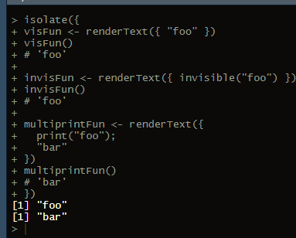
#renderText
isolate({
visFun <- renderText({ "foo" })
visFun()
# 'foo'
invisFun <- renderText({ invisible("foo") })
invisFun()
# 'foo'
multiprintFun <- renderText({
print("foo");
"bar"
})
multiprintFun()
# 'bar'
})

Slide 39
DT::renderUI:
renderUI(expr, env, quoted, func)
Expr: An expression that returns the shiny tag object HTML() or list of such objects
Env: The environment in which to evaluate the expr

Slide 40
Reactivity

Slide 41
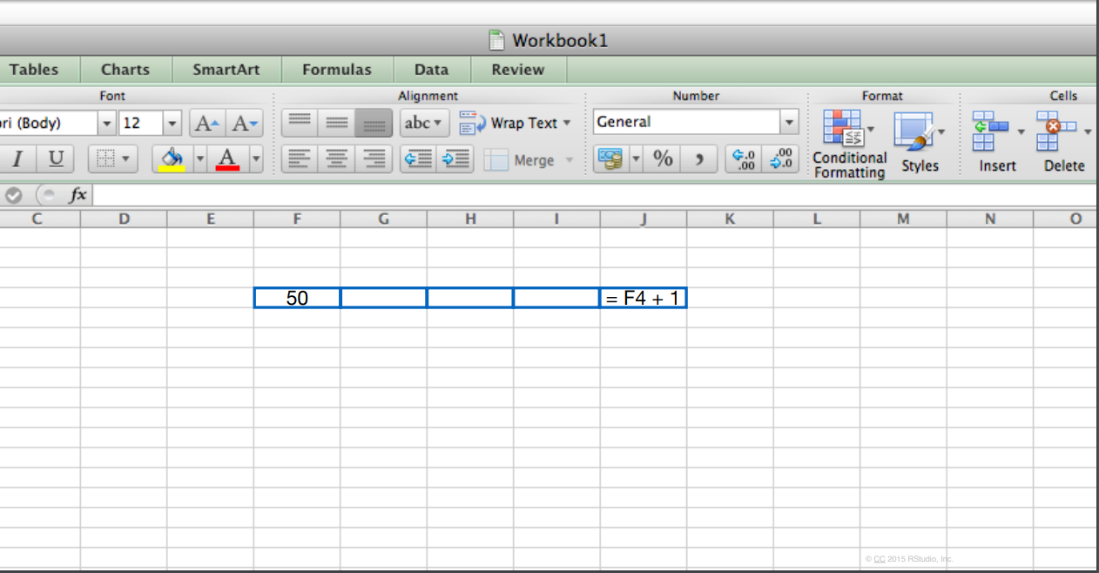

Slide 42
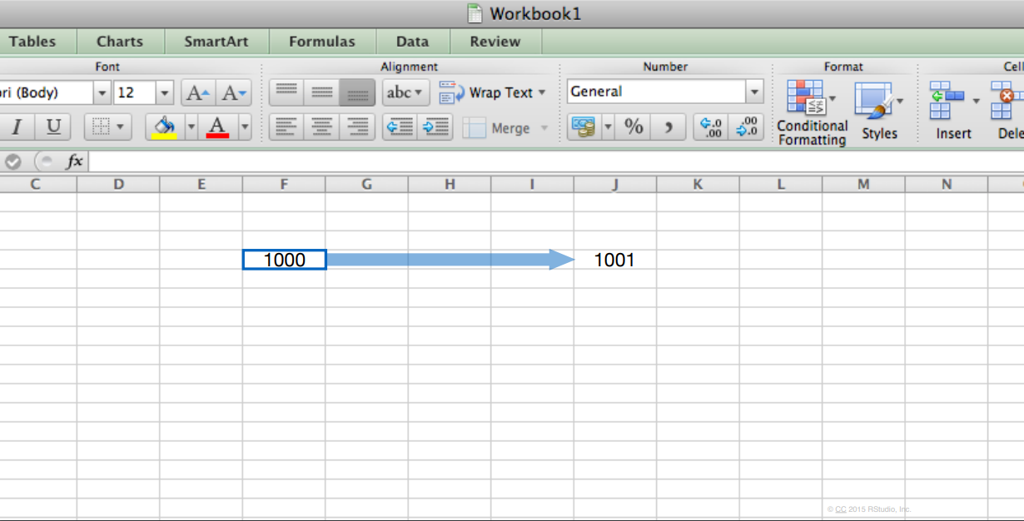

Slide 43
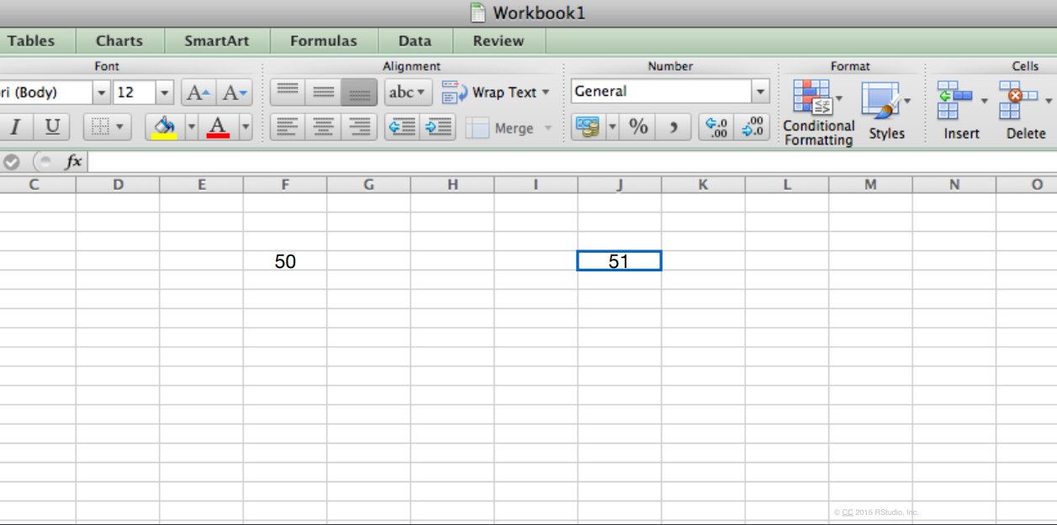

Slide 44
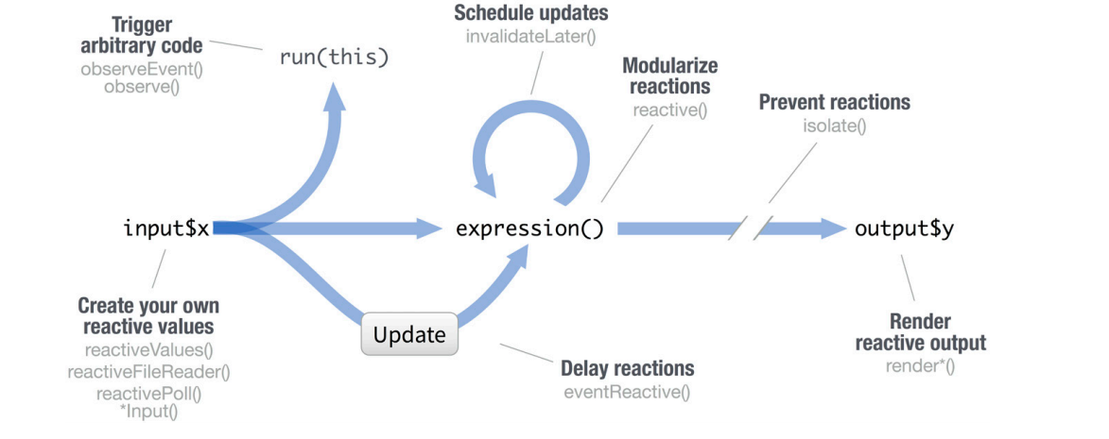

Slide 45
Topics to be covered :
Reactive Values
Modularize Reactions
Prevent Reactions

Slide 46
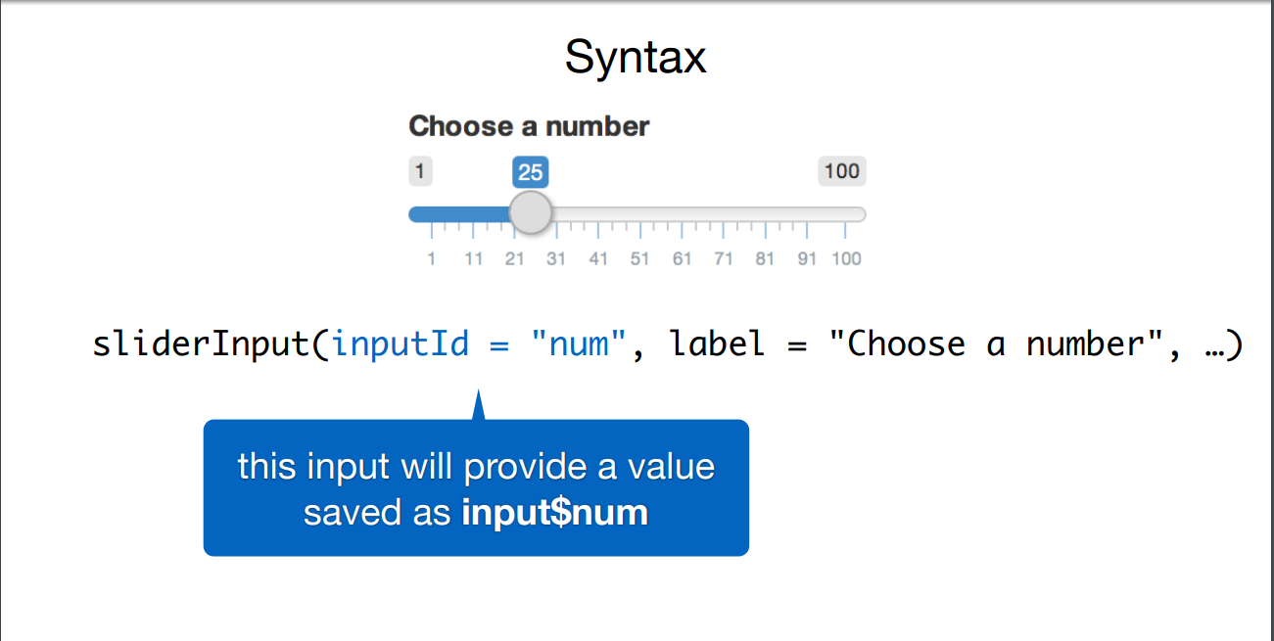

Slide 47
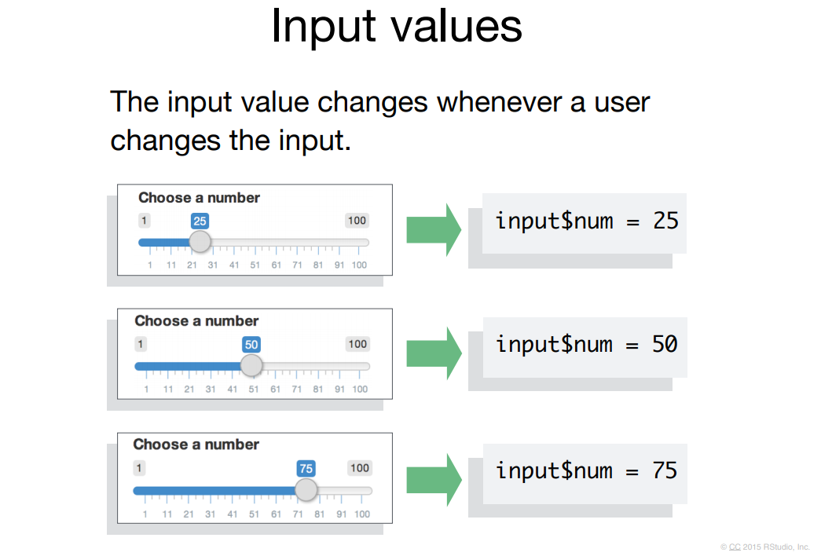

Slide 48
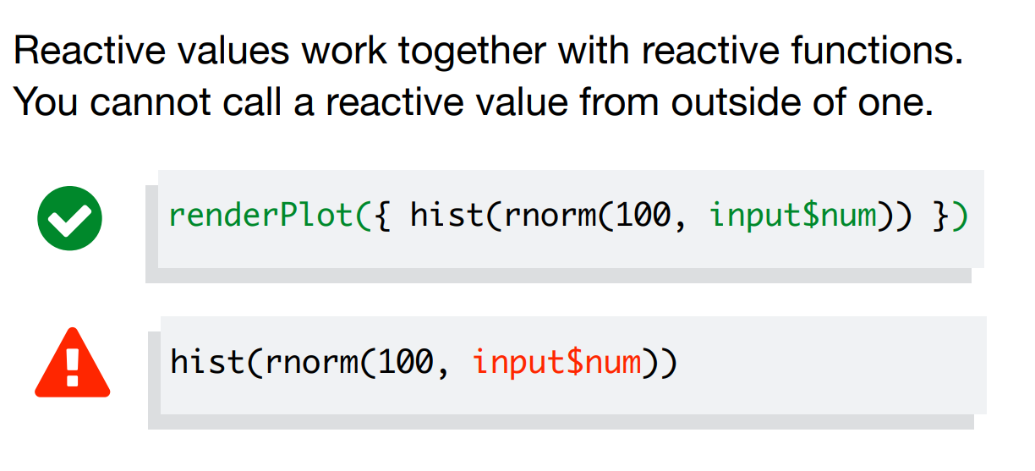

Slide 49
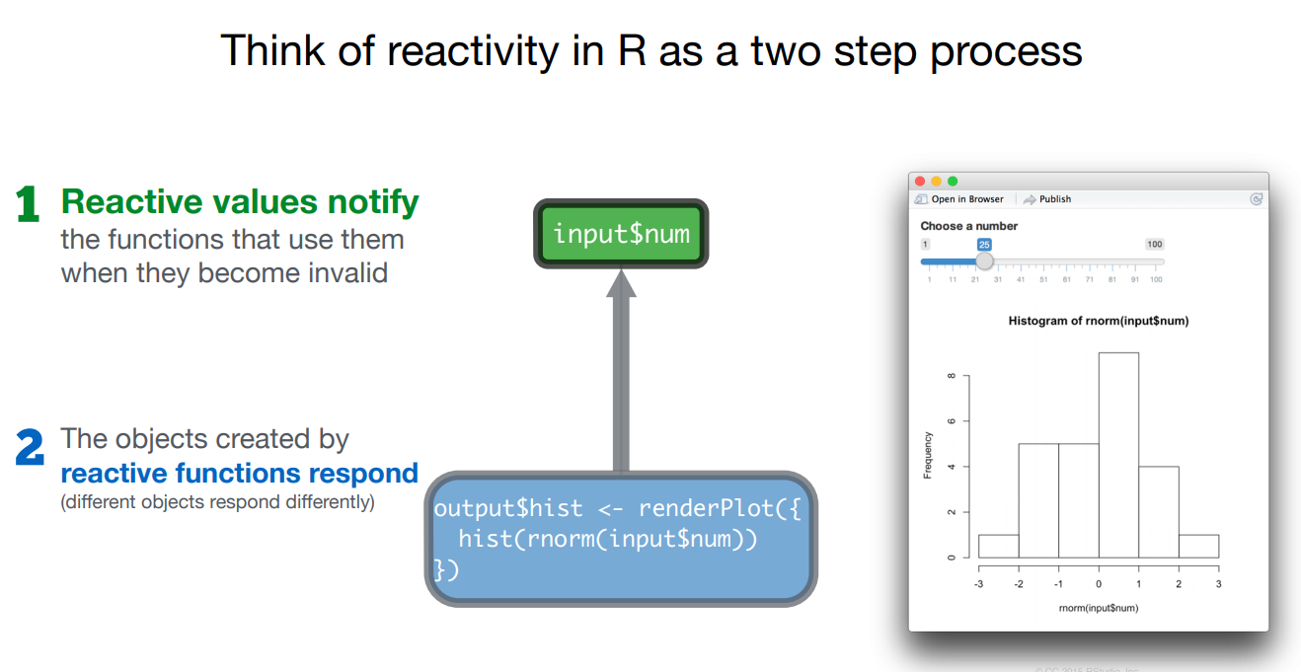

Slide 50
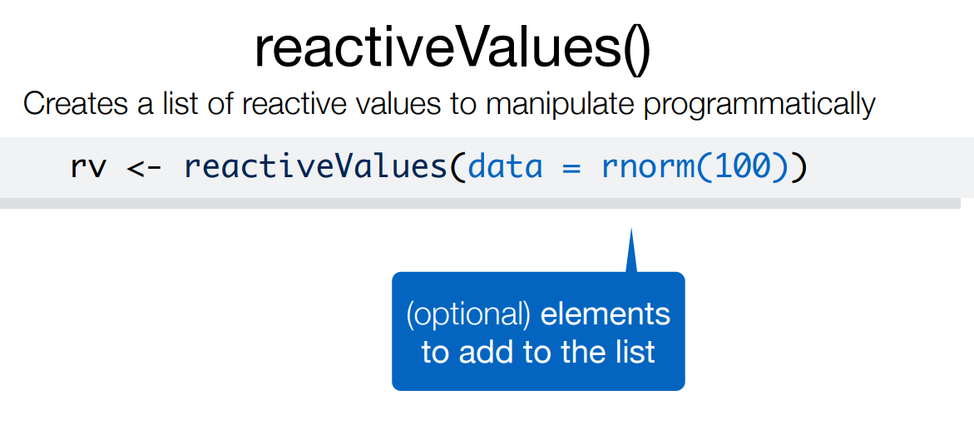

Slide 51
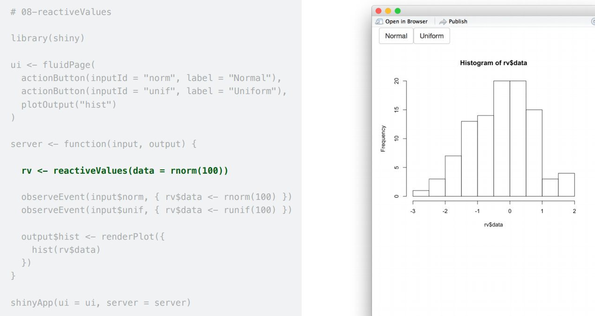

Slide 52
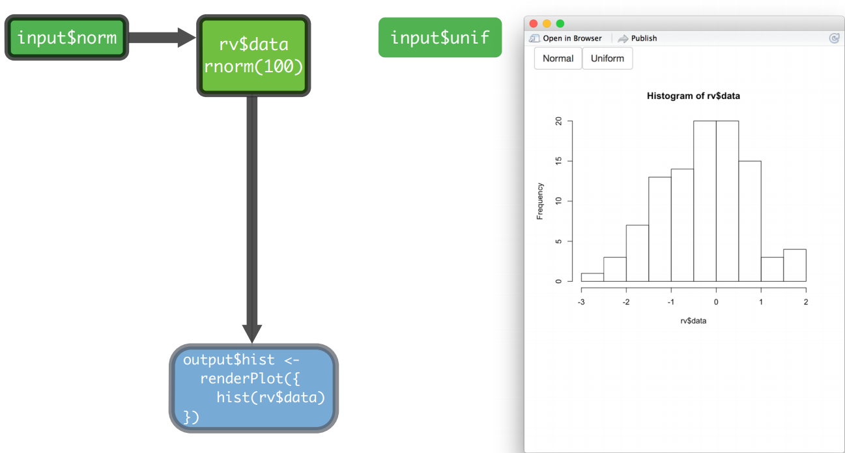

Slide 53
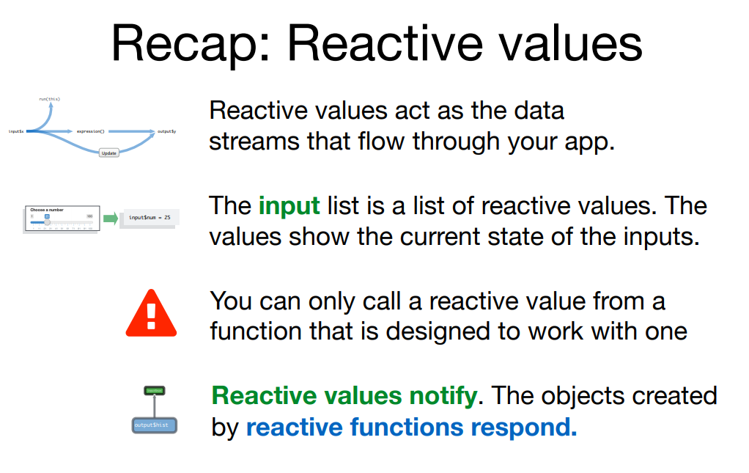

Slide 54
Modularize Reactions
Reactive()

Slide 55
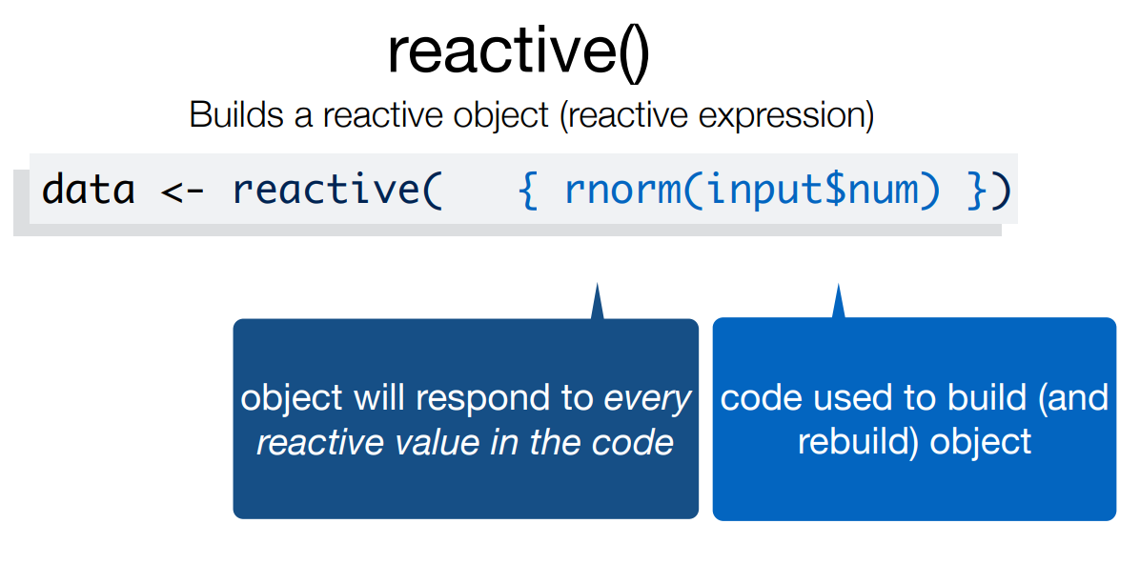

Slide 56
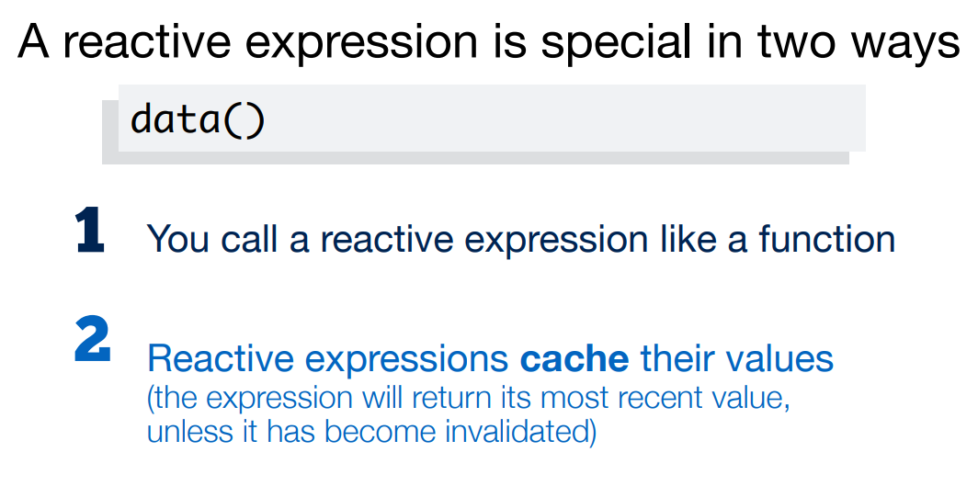

Slide 57
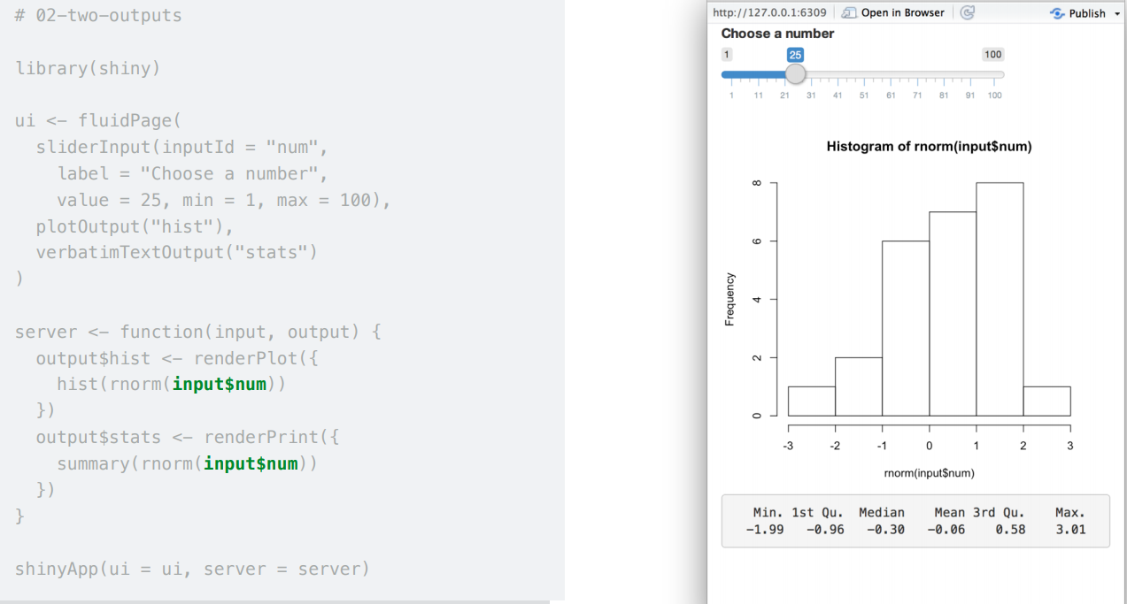

Slide 58
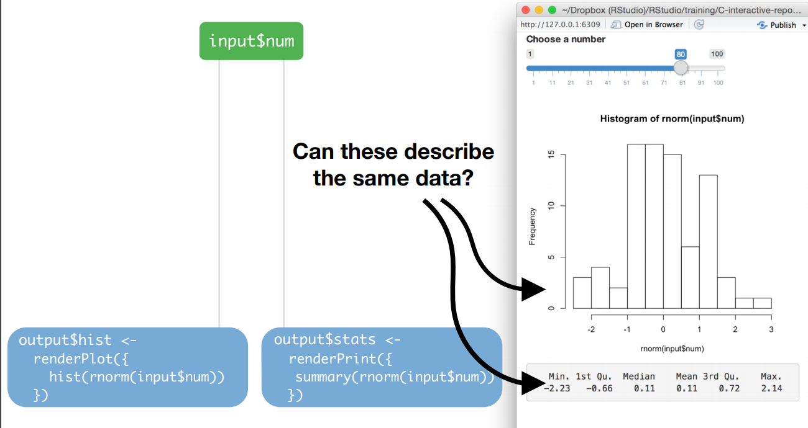

Slide 59
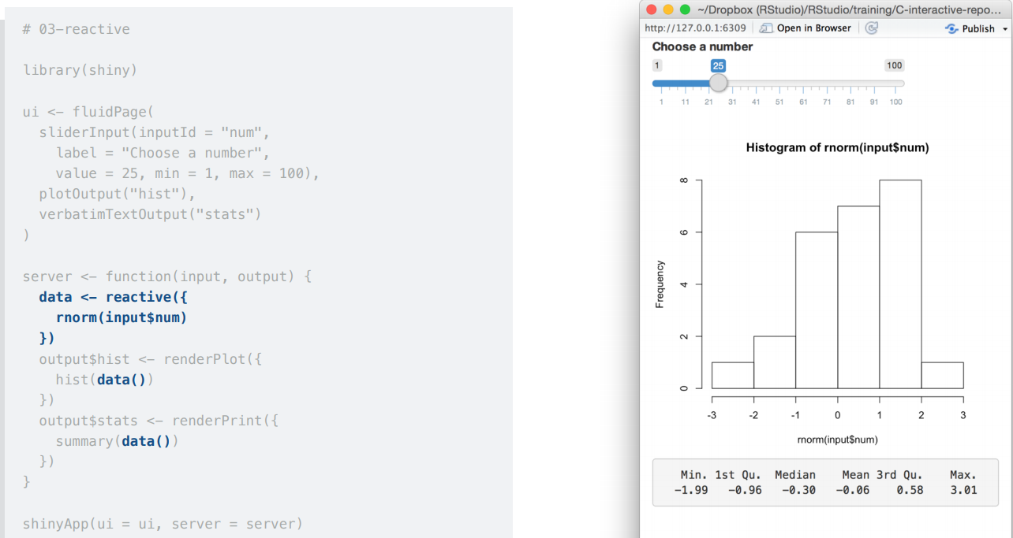

Slide 60
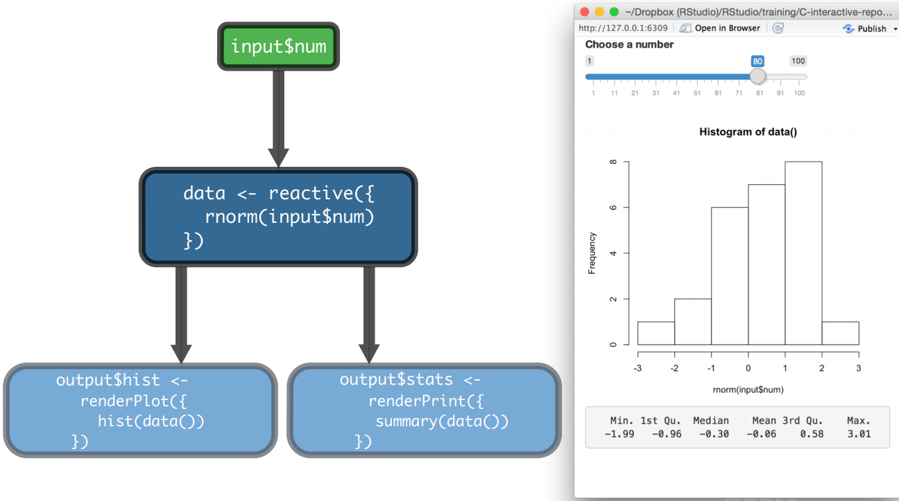

Slide 61
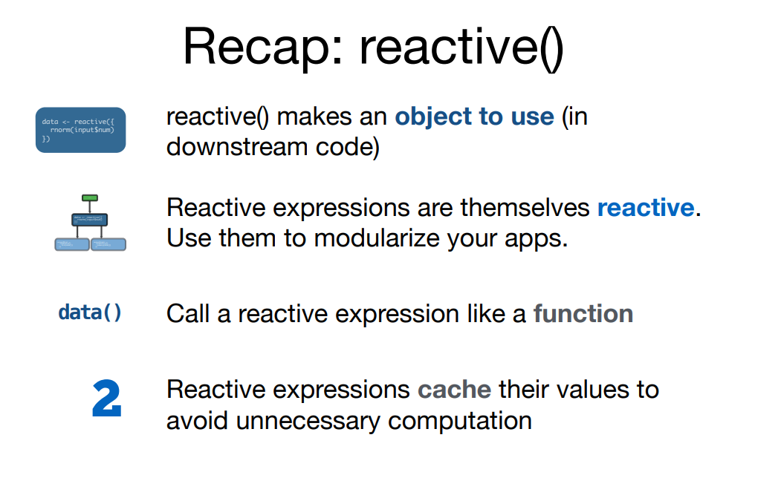

Slide 62
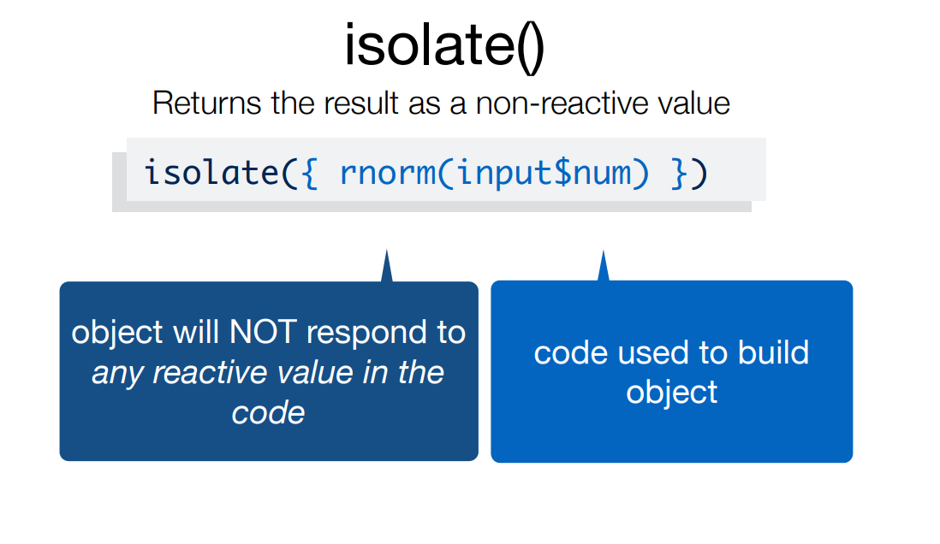

Slide 63
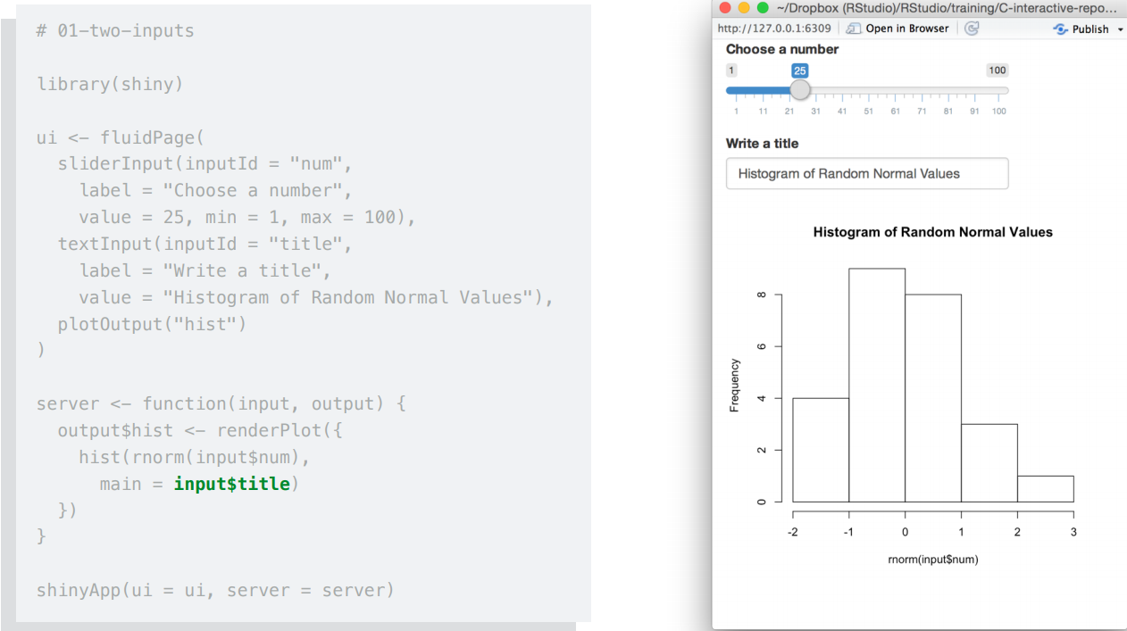

Slide 64
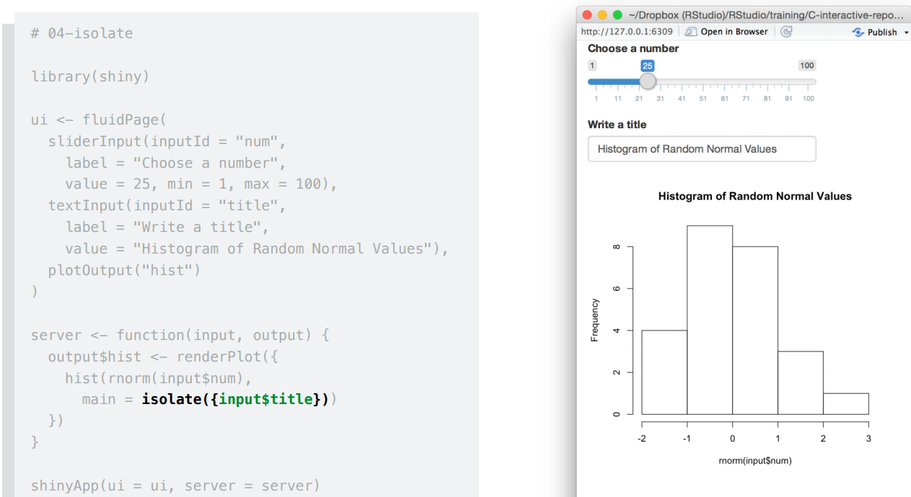

Slide 65
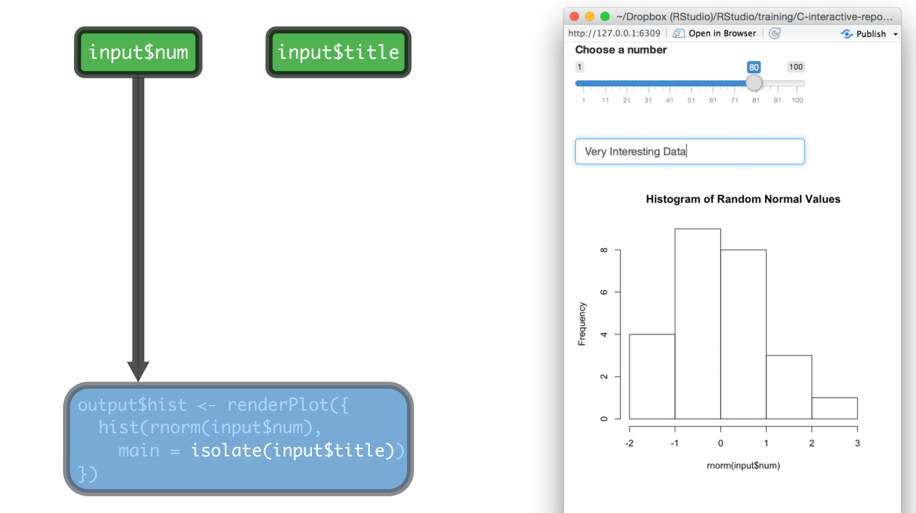

Slide 66
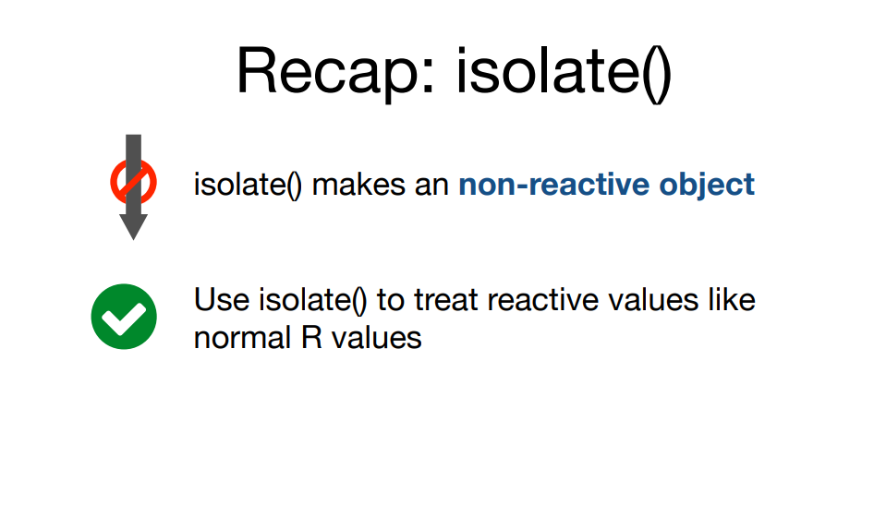

Slide 67


Slide 68


Slide 69


Slide 70


Slide 71


Slide 72


Slide 73


Slide 74


Slide 75


Slide 76


Slide 77


Slide 78


Slide 79


Slide 80


Slide 81
User interface (ui)
HTML
CSS
JS

Slide 82
The user-interface (UI) of a Shiny app is a web document.
Shiny developers can provide this document as an index.html file or assemble it from R code in their “UI” object.
The UI object calls R functions that outputs HTML code.
Shiny turns this code into a web app.

Slide 83


Fluidpage UI

Slide 84


R code => HTML

Slide 85
Adding HTML tags:
Standard HTML tags:
p | <p> | A paragraph of text
h1 – h6 | <h1> <h6> | A first level to sixth level header
a | <a> | A hyper link
br | <br> | A line break (e.g. a blank line)
div | <div> | A division of text with a uniform style
span | <span> | An in-line division of text with a uniform style
pre | <pre> | Text ‘as is’ in a fixed width font
code | <code> | A formatted block of code
img | <img> | An image
strong | <strong> | Bold text
em | <em> | Italicized text
HTML |  | Directly passes a character string as HTML code

Slide 86


Slide 87


Slide 88


Adding HTML tags:
Nonstandard tags:
Using tags$ syntax:

Slide 89


Adding HTML tags:
Nonstandard tags:
Using “withTags” syntax:

Slide 90


Adding HTML tags:
Using raw HTML code:
Using HTML file:
<application-dir>
|-- app.R
|-- www
|-- index.html

Slide 91


Adding CSS:
Using “shinythemes” package:
Using custom themes:
<application-dir>
|-- app.R
|-- www
|-- mytheme.css

Slide 92

Adding CSS:
Live themeSelector():

Slide 93


Slide 94


Slide 95


Adding JavaScript:
JavaScript file under www/:
Using Inline script text:
<application-dir>
|-- app.R
|-- www
|-- myscript.js

Slide 96
Layouts
The simple default layout with a sidebar for inputs and a large main area for output.
Custom application layouts using the Shiny grid layout system.
Segmenting layouts using the Panels.
Creating applications with multiple top-level components using the NavbarPage() Function.

Slide 97
Title Panel
Header Panel
Well Panel
Input Panel
Absolute Panel
Fixed Panel

Slide 98

Panels
Title Panel
Header Panel
Well Panel
Input Panel

Slide 99

Navbar Page
Main Panel
Sidebar Panel
Tab Panel
Tabset Panel

Slide 100


Slide 101
Absolute and Fixed Panel
Creates a panel whose contents are absolutely positioned.
Position can be set as top , bottom , Left , Right .
Absolute panel can be dragged and made collapsible.
Both are same just we need to specify parameter Fixed = “TRUE” for Fixed panel
absolutePanel(bottom = 20, right = 20, width = 300, draggable = TRUE,fixed = FALSE)
fixedPanel(bottom = 20, right = 20, width = 300,draggable = TRUE,fixed = TRUE)

Slide 102


Slide 103
Layout Types
Fluid Row
Flow Layout
Split Layout
Vertical Layout

Slide 104

Flow Layout
tabPanel("FlowLayout()", fluidPage(headerPanel("Flow layout Headerpanel()",tags$style(" {background-color: black;}")), flowLayout( h1("This can be any object "), br(), numericInput("Input", "Select input", 10), br(), h1("And so on...")) ))

Slide 105
Fluid row
tabPanel("FluidRow()", fluidPage(
fluidRow(column(width = 4,h1("With for column here is 4"),inverse=TRUE,style = "background-color: #add8e6;",style = "color: red;"),
column(width = 4,h1("With for column here is 4"),inverse=TRUE,style = "background-color: #add8e6;",style = "color: red;"),
column(width = 4,h1("With for column here is 4"),inverse=TRUE,style = "background-color: #add8e6;",style = "color: red;")),
fluidRow(column(width = 12, h1("Column with width 12"),style = "color: red;",style = "background-color: #add8e6;")),
(column(width = 12, h1("Similarly you can divive this into multiple columns and specify width using Fluidrow() function"),style = "color: red;",style = "background-color: #add8e6;")) )

Slide 106


Slide 107
Vertical layout
fluidPage(verticalLayout(
titlePanel("Vertical layout example"),
plotOutput("plot4"),
h1("Well Panel example"),
wellPanel(sliderInput("ns", "Number of points", 10, 200,
value = 50, step = 10) ),
h1("With out Well Panel "),
sliderInput("ns", "Number of points", 10, 200,
value = 50, step = 10) ) )

Slide 108


Slide 109
Split layout
tabPanel("SplitLayout()",
splitLayout(style = "border: 1px solid silver;", cellWidths = 600, cellArgs = list(style = "padding: 12px"),
plotOutput("plot1"),
plotOutput("plot2"),
plotOutput("plot3")
)
)

Slide 110


Slide 111
Thank You!

